Slide 1
A Supernodal All-Pairs Shortest Path Algorithm
Paper by Piyush Sao, Ramakrishnan Kannan, Prasun Gera, Richard Vuduc
Slides by Hyunmo Sung,
Yonsei university Muti-core programming topics Seminar, Spring 2020

Slide 2
Contents
Introduction
Notations and classic algorithms
Background
Classic Floyd-Warshall algorithm, Min-Plus matrix multiplication, etc..
Supernodal Floyd-Warshall
The method which this paper provide
3
Asymptotic analysis
The numeric analysis of speed-up and efficiency.
4
Conclusion
The experiments and results..

Slide 3
Introduction
Graph notation
1
1
2
Usage
Network congestion control
Navigation system
Computer graphic(Mesh)
Programming model
Many others
1
4
4
3
1
Figure 1.Undirected graph

Slide 4
Introduction
Graph notation
1
1
2
Usage
Network congestion control
Navigation system
Computer graphic(Mesh)
Programming model
Many others
1
4
4
3
1
Figure 1.Undirected graph

Slide 5
Introduction
Graph notation
1
1
2
APSP(All-pairs shortest path algorithm)
Classic SSSP(Single-source shortest path algorithm)
Dijkstra’s algorithm
Bellman-Ford algorithm
Johnson’s algorithm
No good parallelism
Floyd-Warshall algorithm
Blocked version
1
4
4
3
1
Figure 1.Undirected graph

Slide 6
Introduction
Graph notation
1
1
2
APSP(All-pairs shortest path algorithm)
Classic SSSP(Single-source shortest path algorithm)
Dijkstra’s algorithm
Bellman-Ford algorithm
Johnson’s algorithm
No good parallelism
Floyd-Warshall algorithm
Blocked version
1
4
4
3
1
Figure 1.Undirected graph

Slide 7
Introduction
Graph notation
1
1
2
APSP(All-pairs shortest path algorithm)
Classic SSSP(Single-source shortest path algorithm)
Dijkstra’s algorithm
Bellman-Ford algorithm
Johnson’s algorithm
No good parallelism
Floyd-Warshall algorithm
Blocked version
Supernodal Floyd-Warshall
1
4
4
3
1
Figure 1.Undirected graph

Slide 8
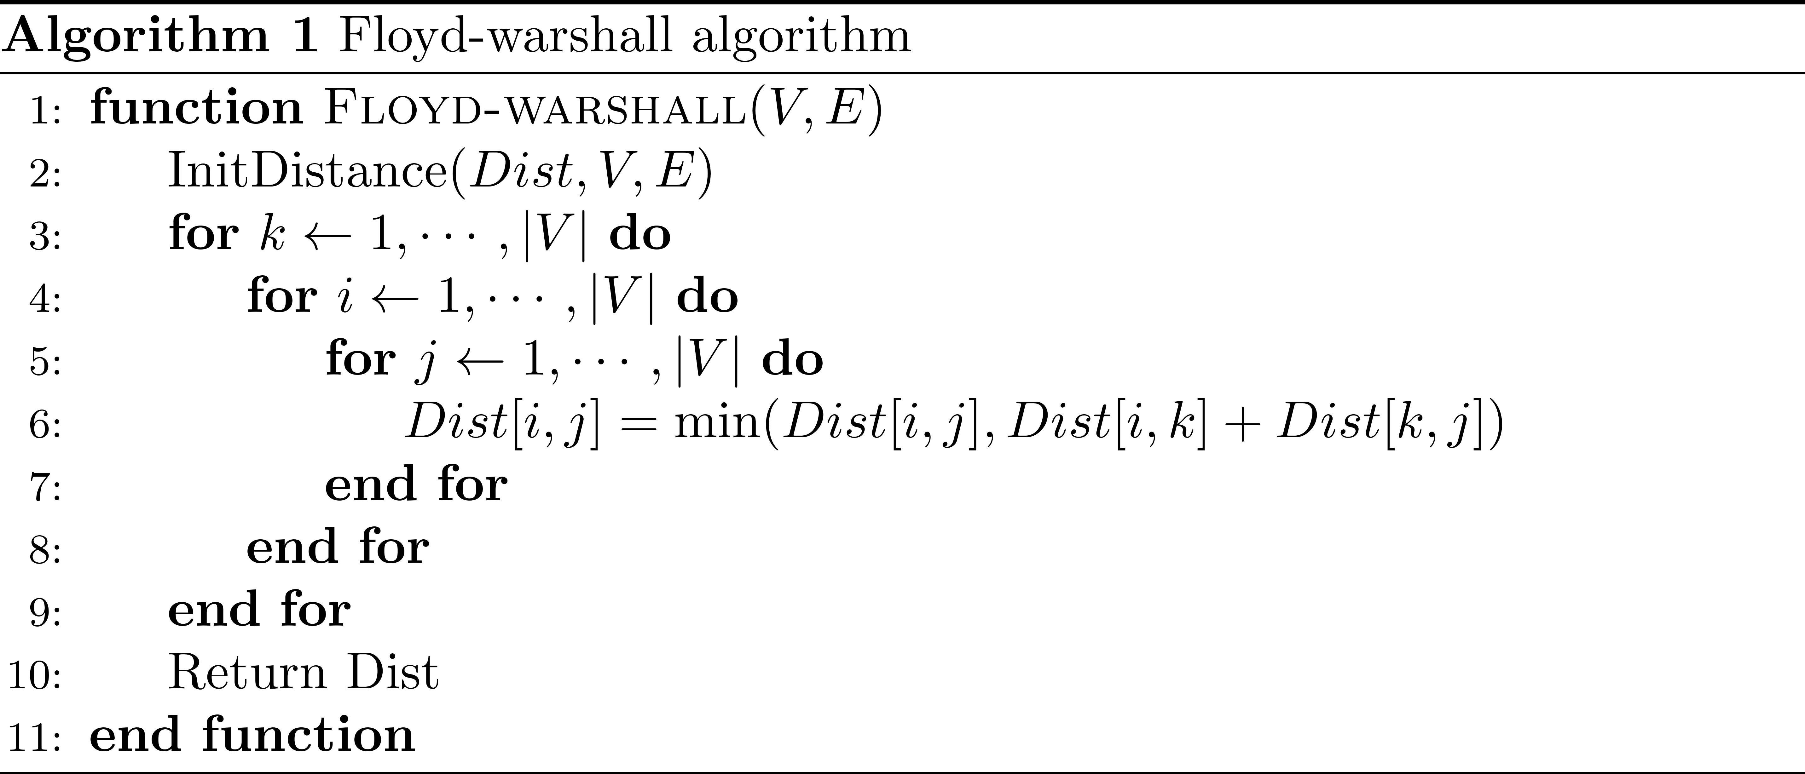
Introduction
Floyd-Warshall algorithm

Slide 9
Introduction
Floyd-Warshall algorithm
Edge relaxing

Slide 10
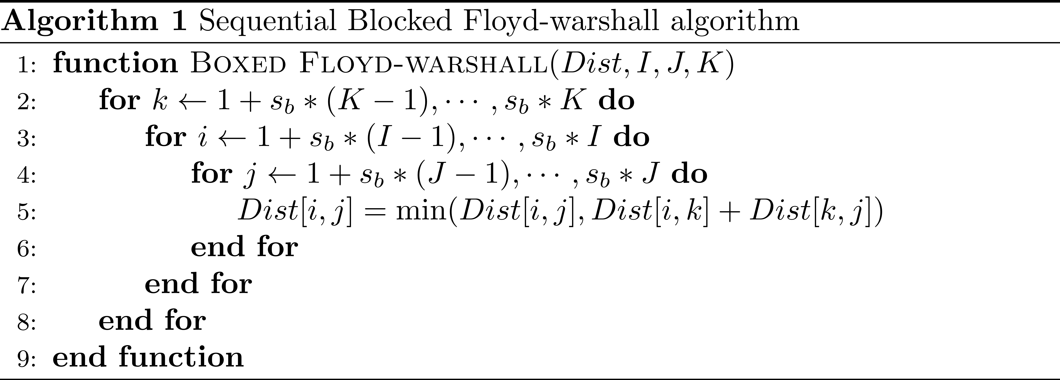
Introduction
Blocked Floyd-Warshall algorithm

Slide 11
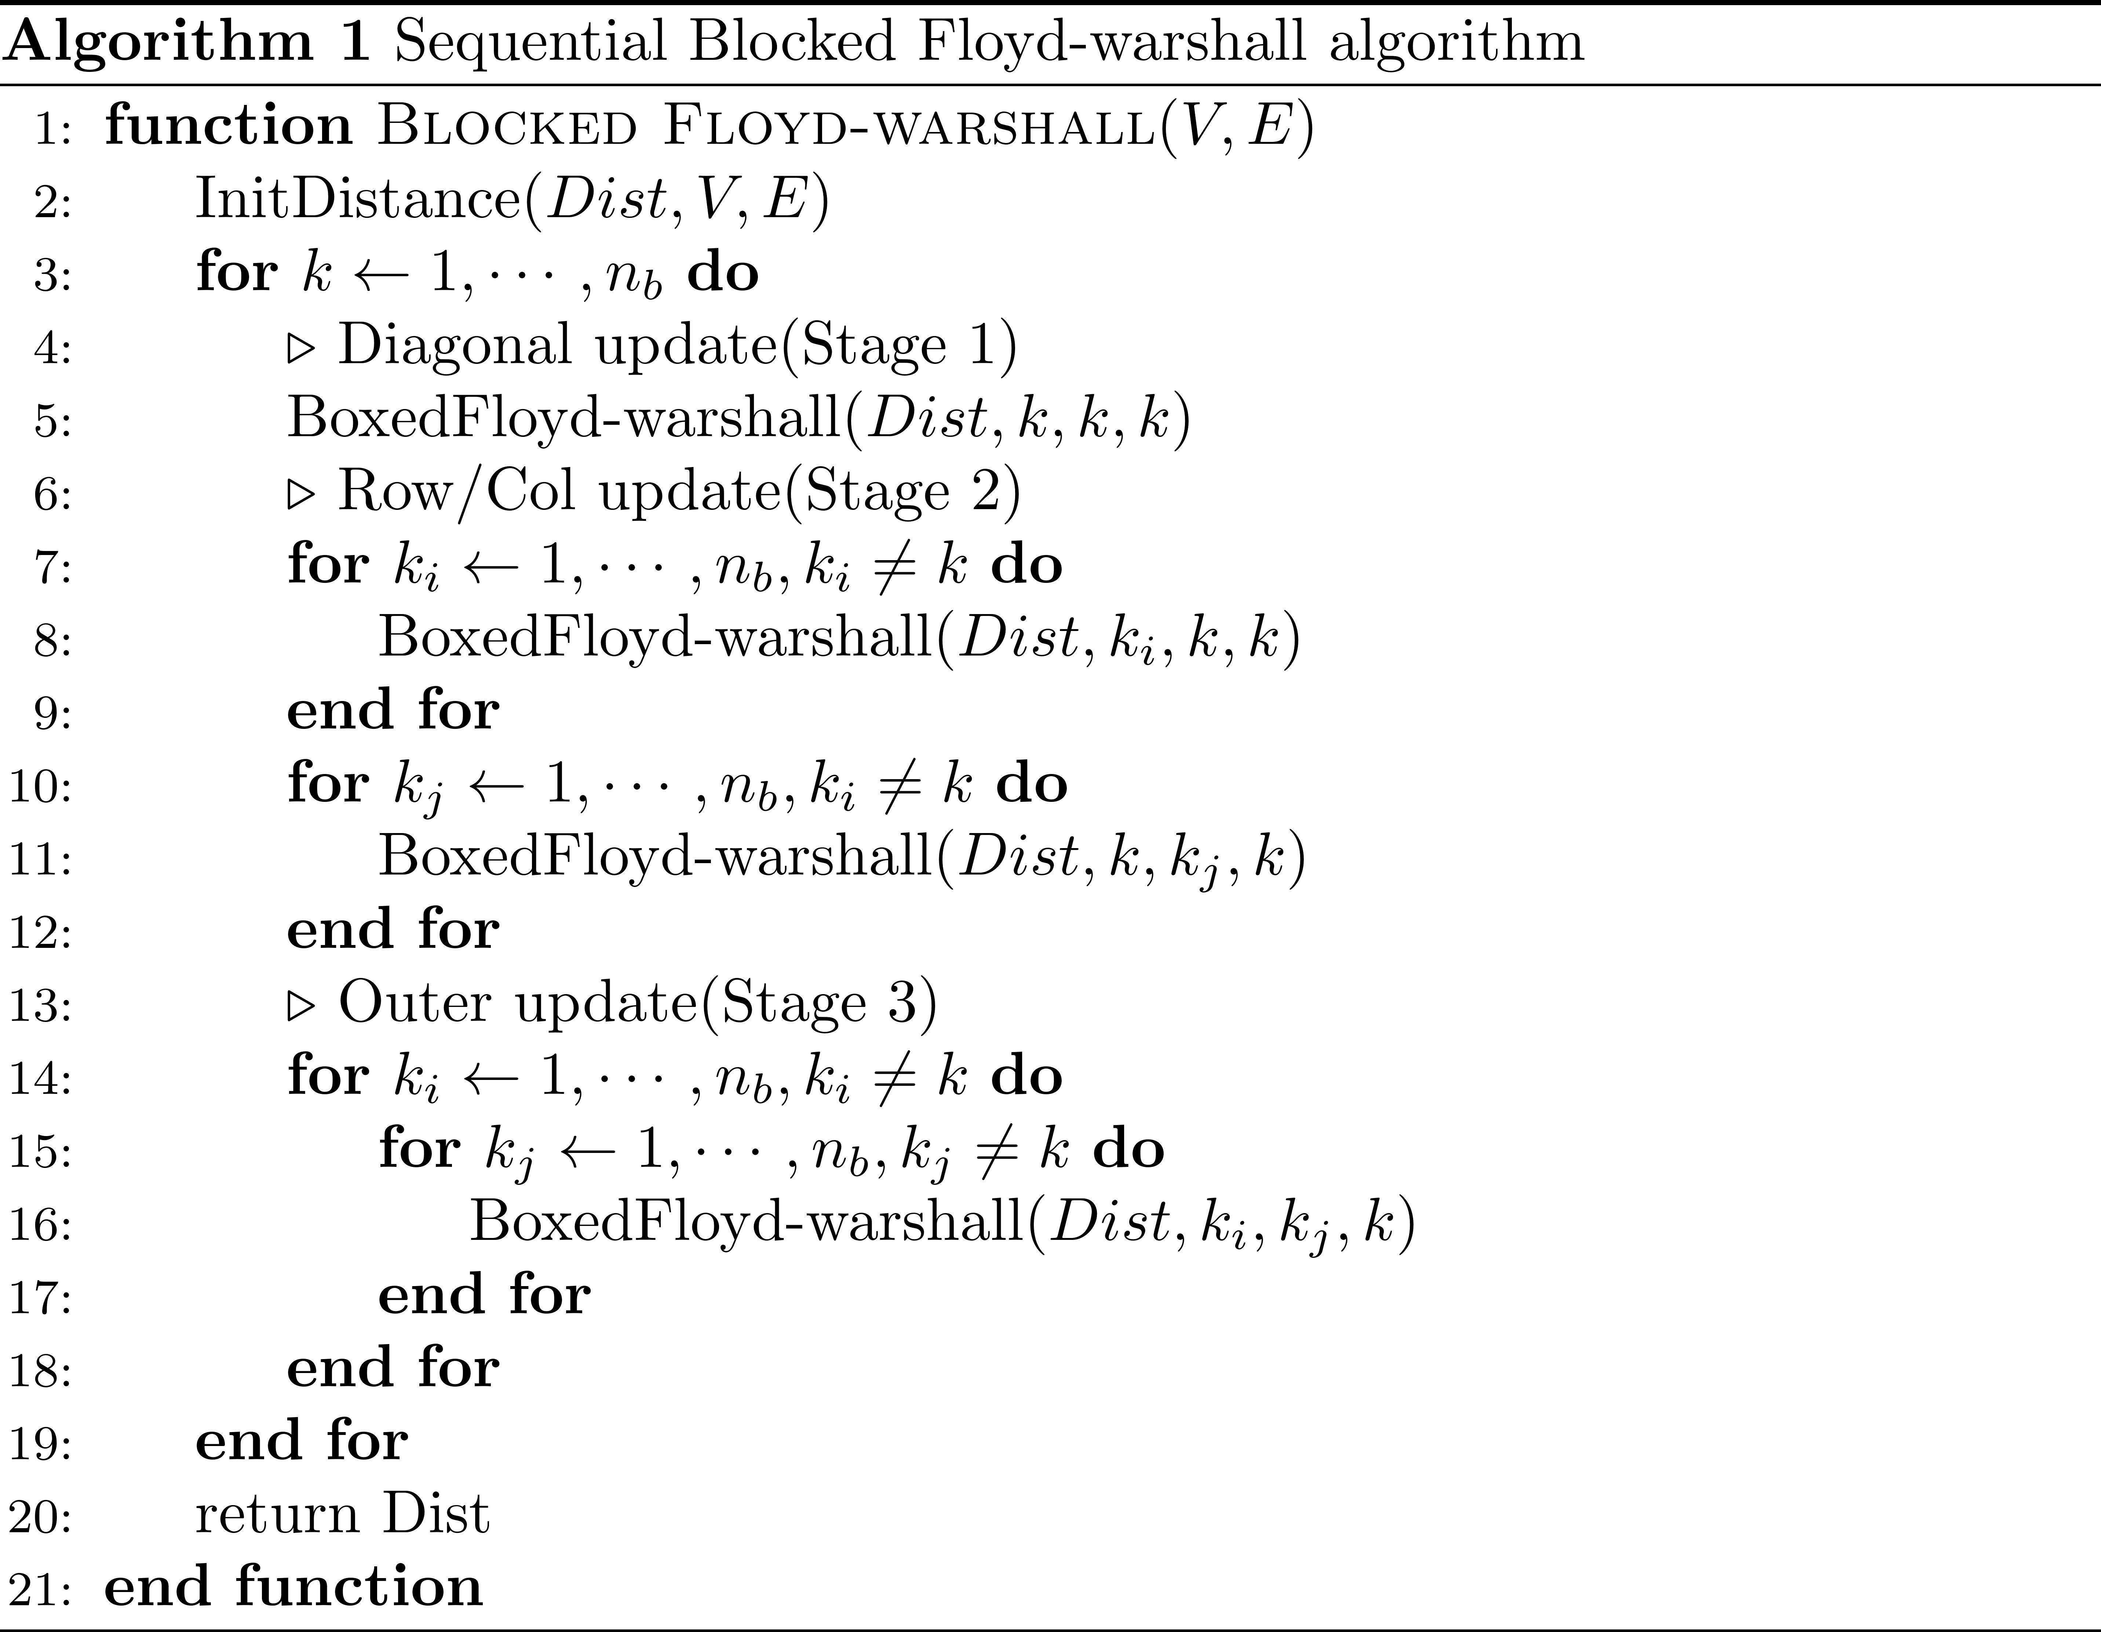
Introduction
Blocked Floyd-Warshall algorithm
Blocked Floyd Warshall
Divide result matrix to blocks
Better parallelism with more iteration step
Lower communication cost

Slide 12
Introduction
Blocked Floyd-Warshall algorithm
Blocked Floyd Warshall
Divide result matrix to blocks
Better parallelism with more iteration step
Lower communication cost

Slide 13
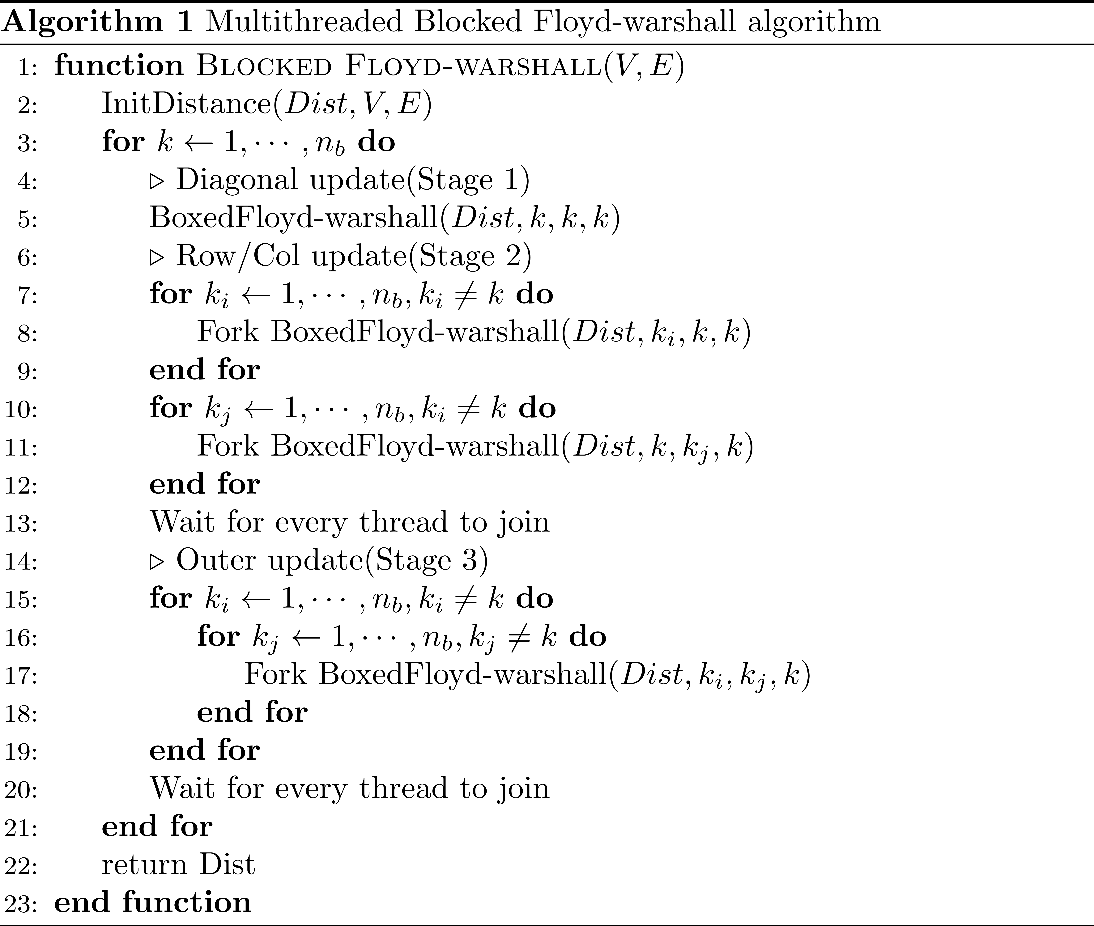
Introduction
Blocked Floyd-Warshall algorithm
Blocked Floyd Warshall
Divide result matrix to blocks
Better parallelism with more iteration step
Lower communication cost

Slide 14
Introduction
Blocked Floyd-Warshall algorithm

Slide 15
Introduction
Blocked Floyd-Warshall algorithm

Slide 16
Introduction
Blocked Floyd-Warshall algorithm
No fork for stage1
Fork per block
Synchronization at the end of stage 2
Fork per block
Synchronization at the end of stage 3

Slide 17
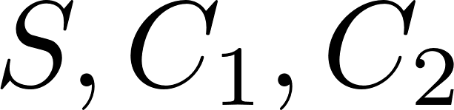



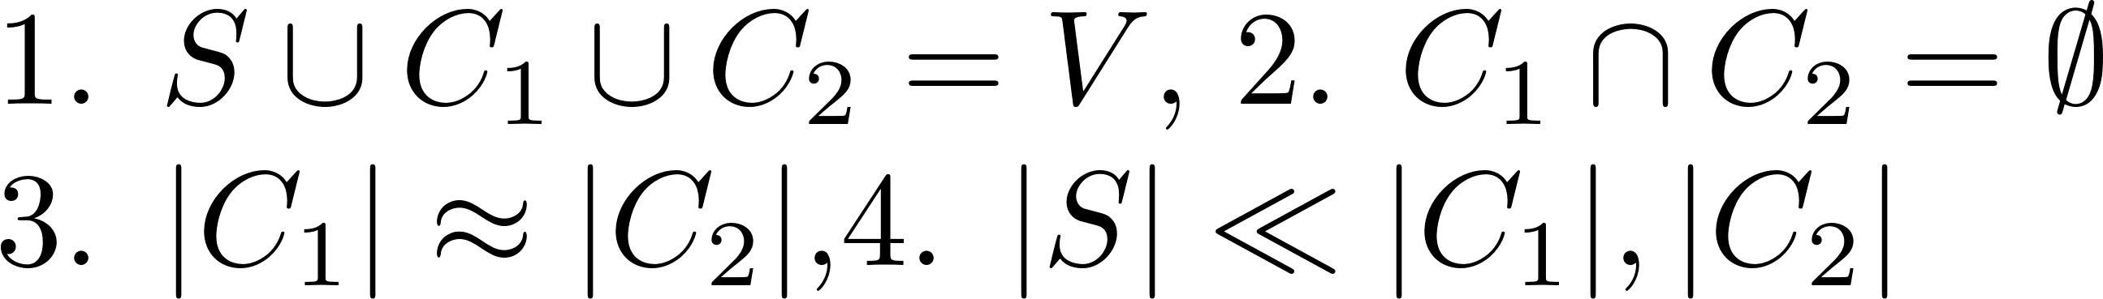

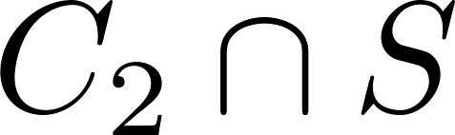

Introduction
Supernodal Floyd-Warshall algorithm
If we can find satisfies under conditions, it can be reordered nicely.
Nested dissection makes graph to
two bisection parts and small separator.
Index of separators will be the biggest.

Slide 18
Introduction
Supernodal Floyd-Warshall algorithm
If we can find satisfies under conditions, it can be reordered nicely.
Nested dissection makes graph to
two bisection parts and small separator.
Index of separators will be the biggest.

Slide 19
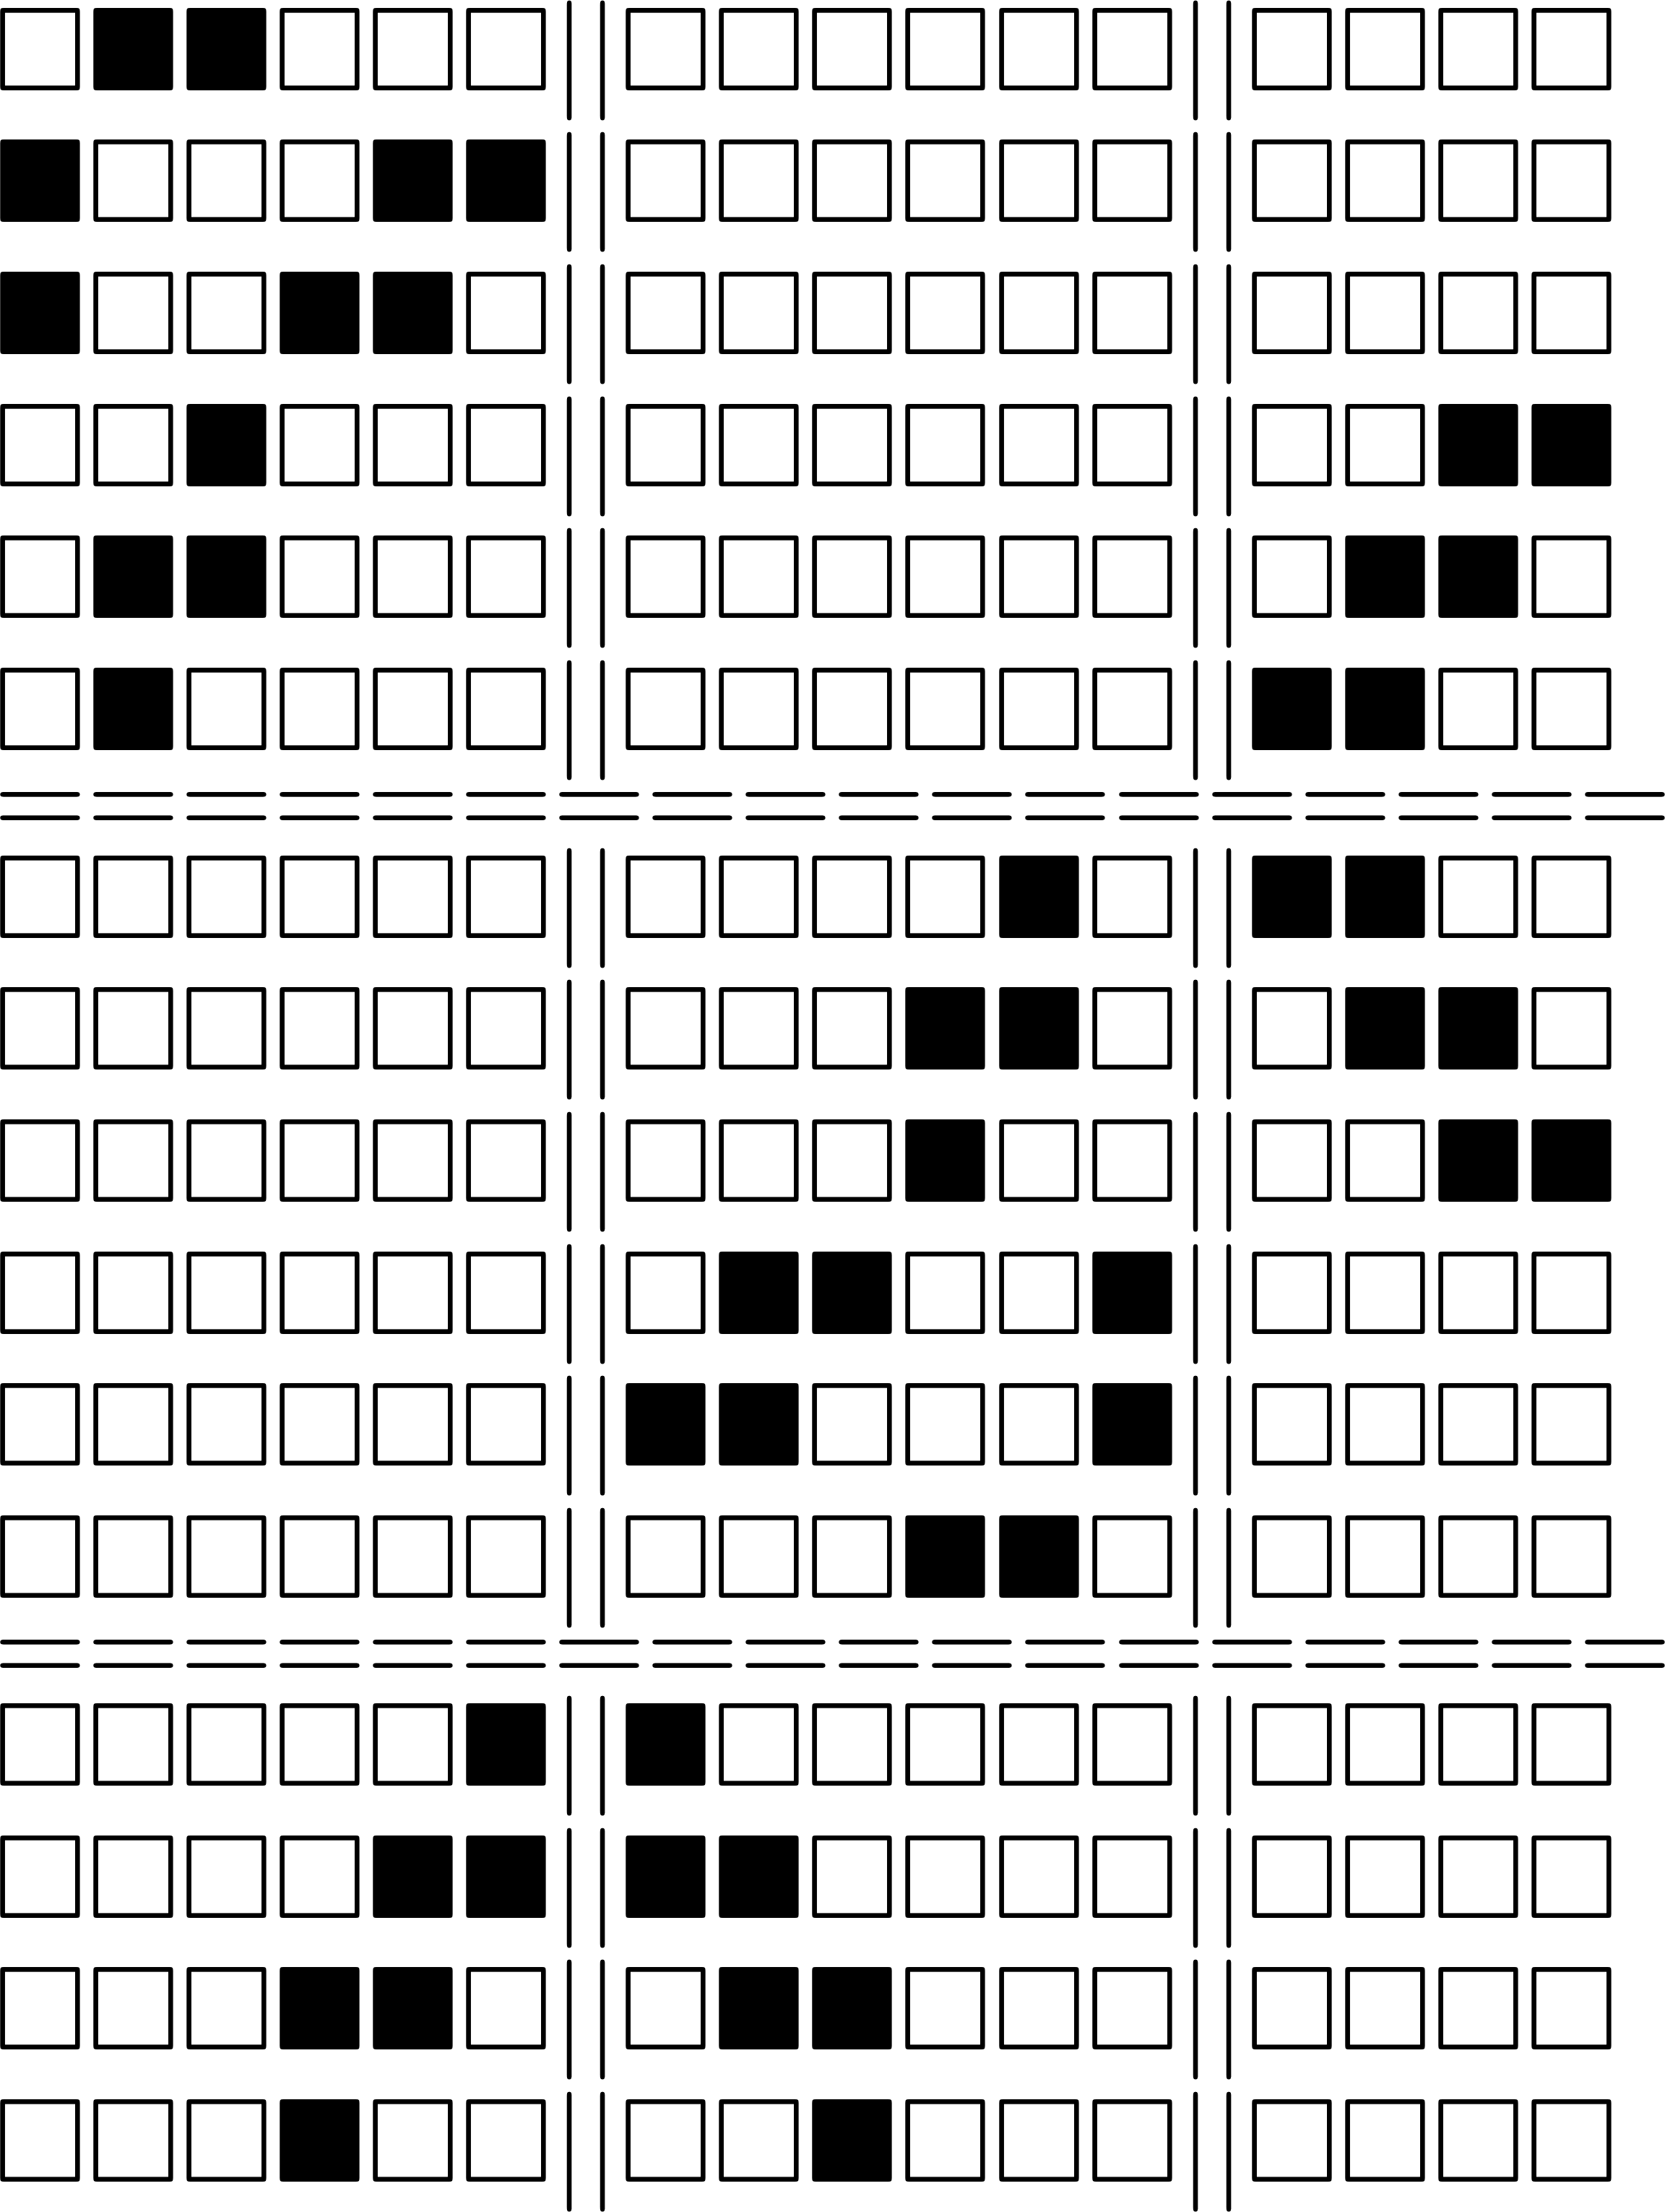
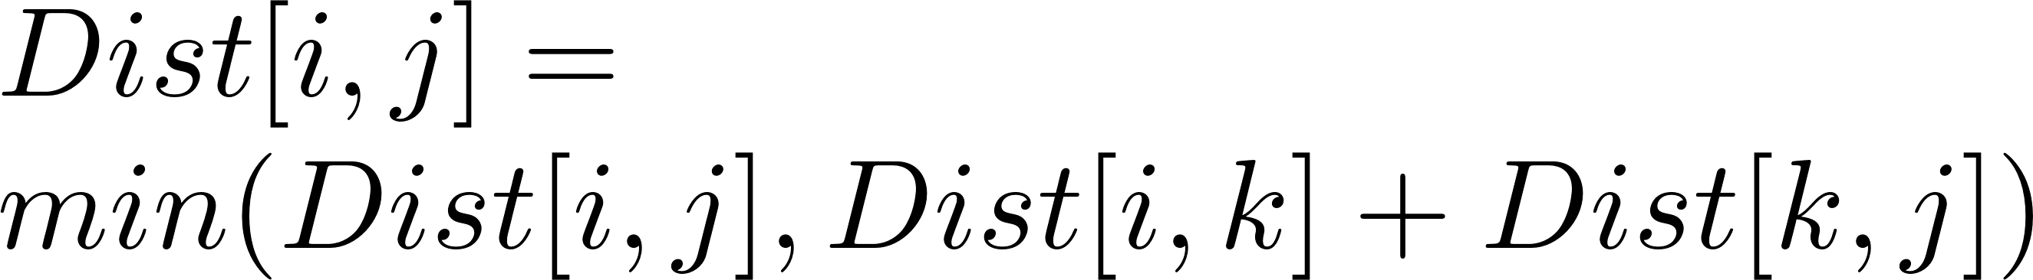
Introduction
Supernodal Floyd-Warshall algorithm

Slide 20
Introduction
Supernodal Floyd-Warshall algorithm

Slide 21
Introduction
Supernodal Floyd-Warshall algorithm
No intersection
Empty space

Slide 22
Introduction
Supernodal Floyd-Warshall algorithm

Slide 23
Introduction
Supernodal Floyd-Warshall algorithm
This an infinity.
This an infinity.

Slide 24
Introduction
Supernodal Floyd-Warshall algorithm
13
14
15
16
Elimination tree
Tree structure from nested dissection
Originated from Cholesky factorization
Implementation
Cuthill–McKee algorithm
BFS implementation
METIS
5
6
11
12
1
3
7
9
2
4
8
10

Slide 25
Introduction
Supernodal Floyd-Warshall algorithm
5
3
4
13
1
2
3
4
2
6
14
7
5
6
7
8
1
15
12
8
9
10
11
12
13
14
15
16
16
9
10
11

Slide 26
Introduction
Supernodal Floyd-Warshall algorithm
5
3
4
13
13
14
15
16
2
6
14
7
1
2
7
8
1
15
12
8
3
4
9
10
16
9
10
11
5
6
11
12

Slide 27
Introduction
Supernodal Floyd-Warshall algorithm
5
3
4
13
13
14
15
16
2
6
14
7
5
6
11
12
1
15
12
8
1
3
7
9
16
9
10
11
2
4
8
10

Slide 28
Introduction
Supernodal Floyd-Warshall algorithm
5
3
4
13
13
14
15
16
No connection
2
6
14
7
5
6
11
12
1
15
12
8
1
3
7
9
16
9
10
11
2
4
8
10

Slide 29
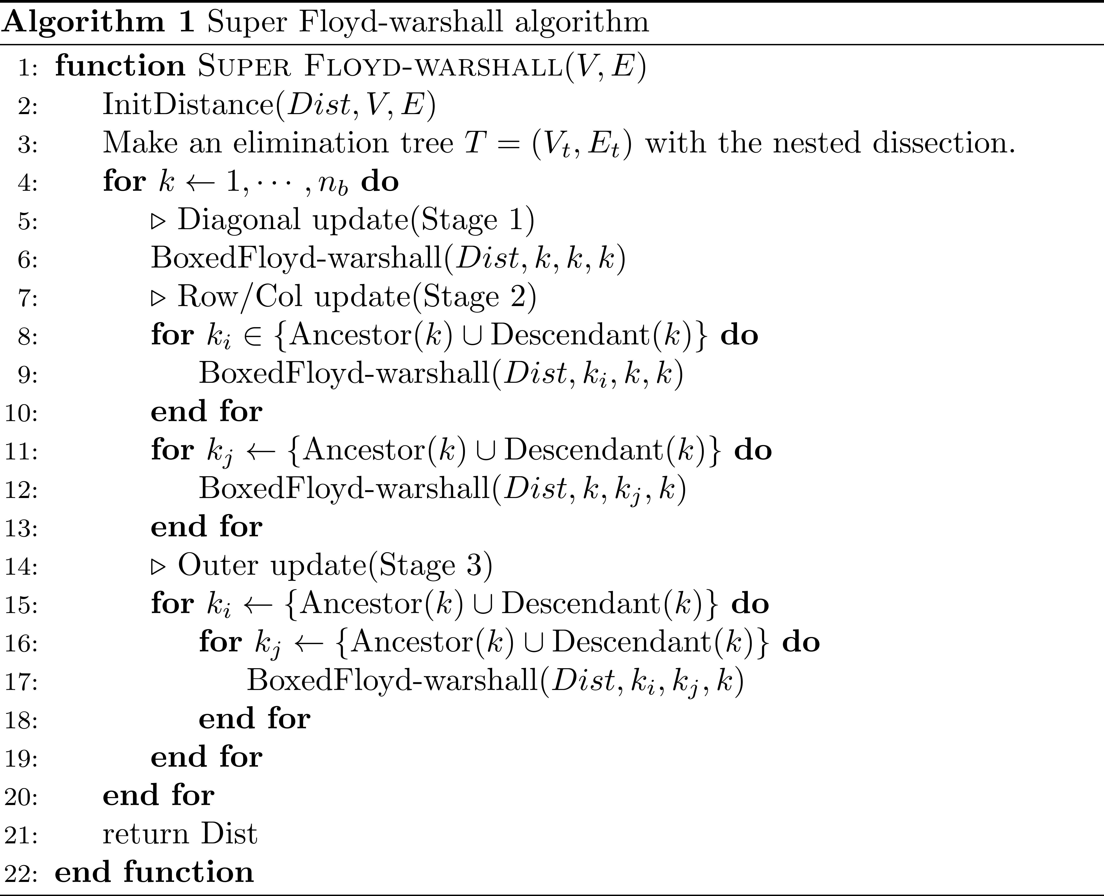
Introduction
Supernodal Floyd-Warshall algorithm
Supernodal Floyd-Warshall
Extension of Blocked Floyd-Warshall
Ignore empty space
Lower work complexity
Even more parallelism

Slide 30
Introduction
Supernodal Floyd-Warshall algorithm
Supernodal Floyd-Warshall
Extension of Blocked Floyd-Warshall
Ignore empty space
Lower work complexity
Even more parallelism

Slide 31
Introduction
Supernodal Floyd-Warshall algorithm

Slide 32
Introduction
Supernodal Floyd-Warshall algorithm

Slide 33
Introduction
Supernodal Floyd-Warshall algorithm
Supernodal Floyd-Warshall
No data collision at stage 1, stage 2, stage 3 over Descendant
More parallelism point

Slide 34
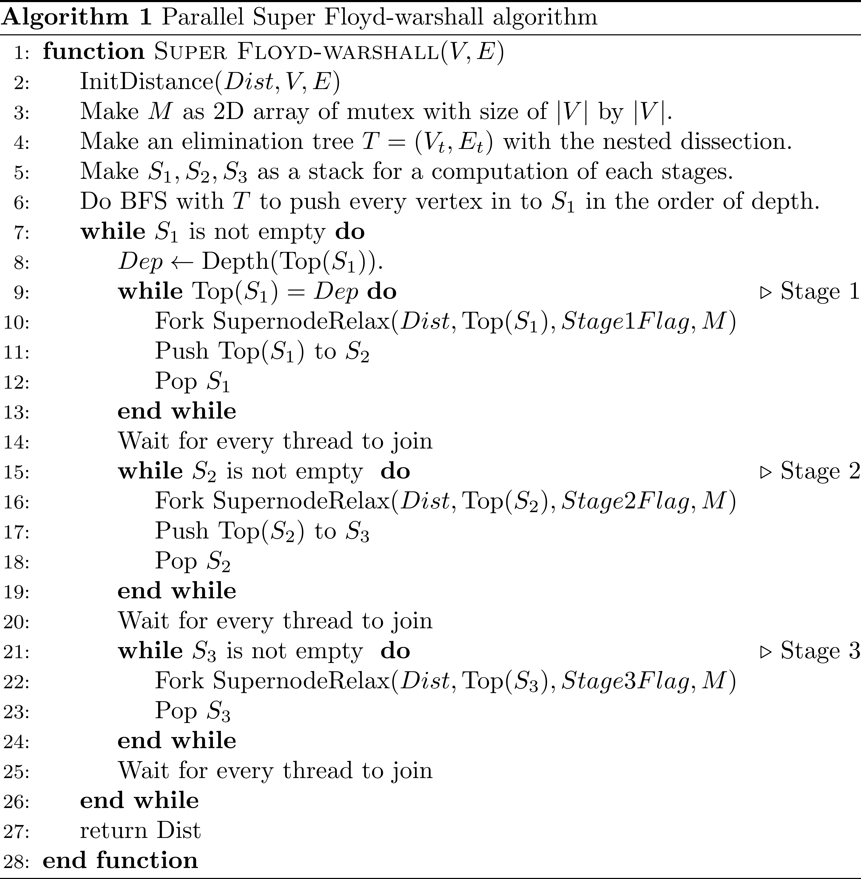
Implementation
Supernodal Floyd-Warshall algorithm
Supernodal Floyd-Warshall
BFS with Elimination tree.
Wrapping function for a node relaxing with supernodes.
Synchronization between stage

Slide 35
Implementation
Supernodal Floyd-Warshall algorithm
Supernodal Floyd-Warshall
BFS with Elimination tree.
Wrapping function for a node relaxing with supernodes.
Synchronization between stage

Slide 36
Implementation
Supernodal Floyd-Warshall algorithm
Supernodal Floyd-Warshall
BFS with Elimination tree.
Wrapping function for a node relaxing with supernodes.
Synchronization between stage

Slide 37
Implementation
Supernodal Floyd-Warshall algorithm
13
14
15
16
5
6
11
12
1
3
7
9
2
4
8
10

Slide 38
Implementation
Supernodal Floyd-Warshall algorithm
13
14
15
16
5
6
11
12
Stage 1
1
3
7
9
2
4
8
10

Slide 39
Implementation
Supernodal Floyd-Warshall algorithm
13
14
15
16
5
6
11
12
Stage 2
1
3
7
9
2
4
8
10

Slide 40
Implementation
Supernodal Floyd-Warshall algorithm
13
14
15
16
5
6
11
12
Stage 3
1
3
7
9
2
4
8
10

Slide 41
Implementation
Supernodal Floyd-Warshall algorithm
13
14
15
16
Stage 1
5
6
11
12
1
3
7
9
2
4
8
10

Slide 42
Implementation
Supernodal Floyd-Warshall algorithm
13
14
15
16
Stage 2
5
6
11
12
1
3
7
9
2
4
8
10

Slide 43
Implementation
Supernodal Floyd-Warshall algorithm
13
14
15
16
Stage 3
5
6
11
12
1
3
7
9
2
4
8
10

Slide 44
Implementation
Supernodal Floyd-Warshall algorithm
13
14
15
16
Stage 1
5
6
11
12
1
3
7
9
2
4
8
10

Slide 45
Implementation
Supernodal Floyd-Warshall algorithm
13
14
15
16
Stage 2
5
6
11
12
1
3
7
9
2
4
8
10

Slide 46
Implementation
Supernodal Floyd-Warshall algorithm
13
14
15
16
Stage 3
5
6
11
12
1
3
7
9
2
4
8
10

Slide 47
Implementation
Supernodal Floyd-Warshall algorithm
13
14
15
16
5
6
11
12
1
3
7
9
2
4
8
10

Slide 48
Implementation
Supernodal Floyd-Warshall algorithm
13
14
15
16
5
6
11
12
Stage 2
1
3
7
9
2
4
8
10

Slide 49
Implementation
Supernodal Floyd-Warshall algorithm
13
14
15
16
5
6
11
12
Stage 2
1
Fork parent
3
7
9
2
4
8
10

Slide 50
Implementation
Supernodal Floyd-Warshall algorithm
13
14
15
16
5
6
11
12
Stage 2
1
3
7
9
2
4
8
10

Slide 51
Implementation
Supernodal Floyd-Warshall algorithm
13
14
15
16
Fork parent
5
6
11
12
Stage 2
1
3
7
9
2
4
8
10

Slide 52
Implementation
Supernodal Floyd-Warshall algorithm
13
14
15
16
5
6
11
12
Stage 2
1
3
7
9
2
4
8
10

Slide 53
Implementation
Supernodal Floyd-Warshall algorithm
13
14
15
16
5
6
11
12
Stage 2
1
3
7
9
2
4
8
10

Slide 54
Implementation
Supernodal Floyd-Warshall algorithm
Stage 2
13
14
15
16
5
6
11
12
1
3
7
9
2
4
8
10

Slide 55
Implementation
Supernodal Floyd-Warshall algorithm
Stage 2
13
14
15
16
5
6
11
12
1
3
7
9
2
4
8
10

Slide 56
Implementation
Supernodal Floyd-Warshall algorithm
Stage 2
Fork children
13
14
15
16
5
6
11
12
1
3
7
9
2
4
8
10

Slide 57
Implementation
Supernodal Floyd-Warshall algorithm
Stage 2
13
14
15
16
5
6
11
12
1
3
7
9
2
4
8
10

Slide 58
Implementation
Supernodal Floyd-Warshall algorithm
Stage 2
13
14
15
16
Fork children
Fork children
5
6
11
12
1
3
7
9
2
4
8
10

Slide 59
Implementation
Supernodal Floyd-Warshall algorithm
Stage 2
13
14
15
16
5
6
11
12
1
3
7
9
2
4
8
10

Slide 60
Implementation
Supernodal Floyd-Warshall algorithm

Slide 61
Implementation
Supernodal Floyd-Warshall algorithm
Naïve Floyd-Warshall

Slide 62
Implementation
Supernodal Floyd-Warshall algorithm
Flag: Row
Iterate the tree
Flag: Col

Slide 63
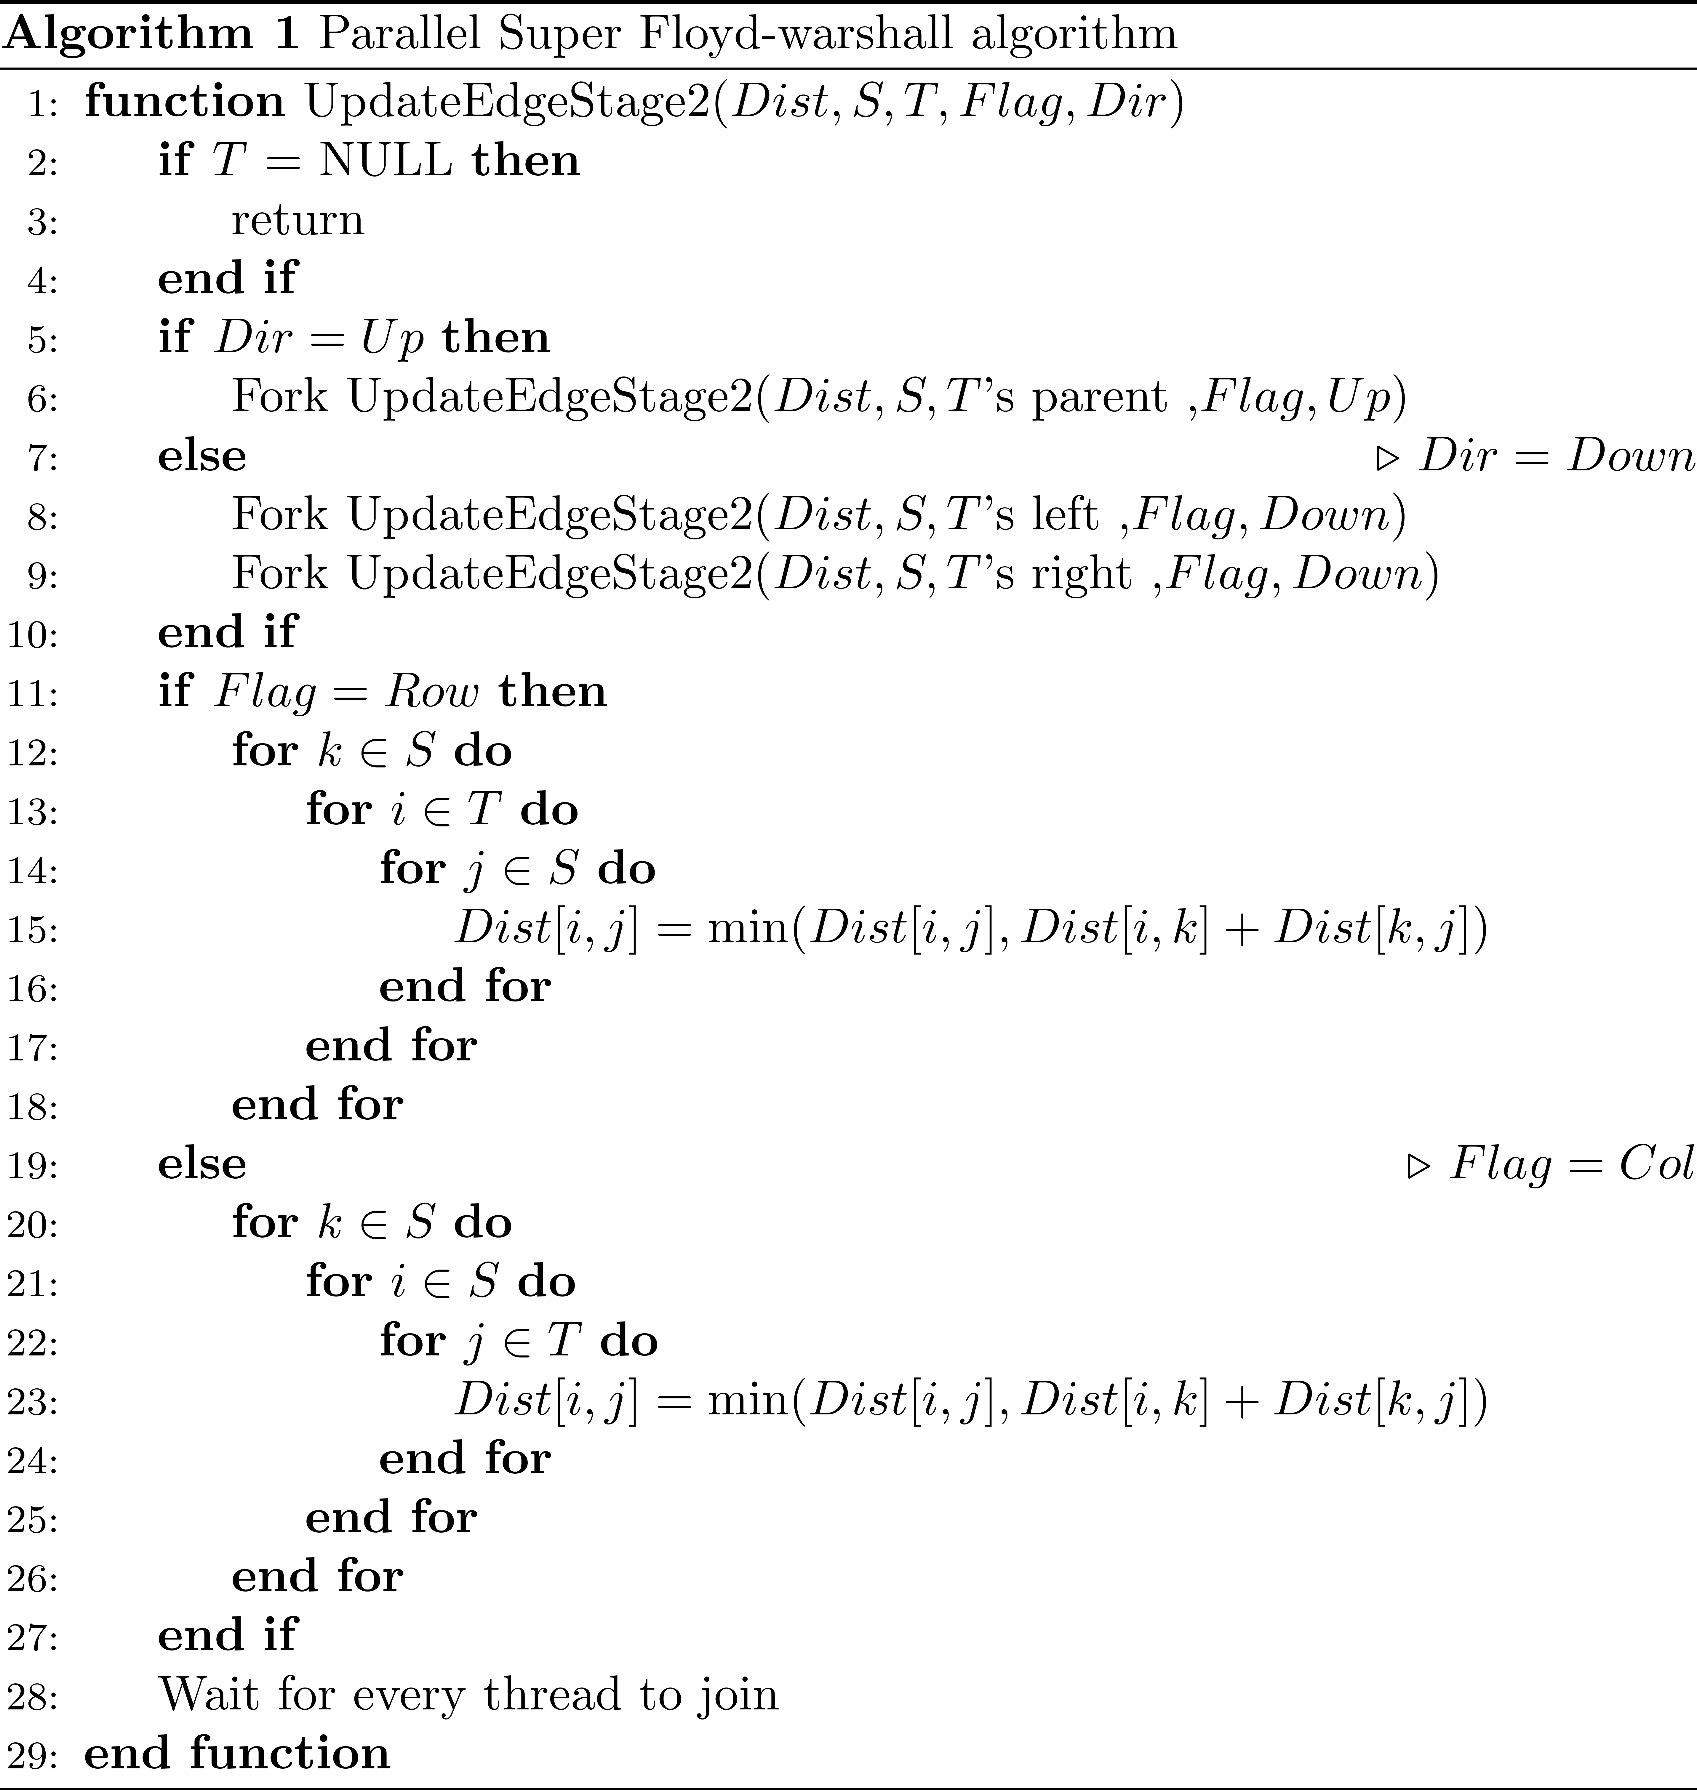
Implementation
Supernodal Floyd-Warshall algorithm
Iterate tree
Flag: Row
Flag: Col

Slide 64
Implementation
Supernodal Floyd-Warshall algorithm
Flag: Row
Flag: Row
Flag: Col
Flag: Col

Slide 65
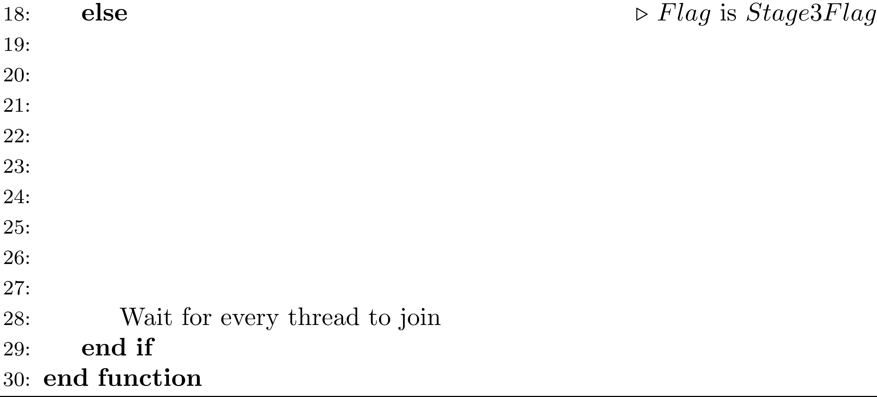
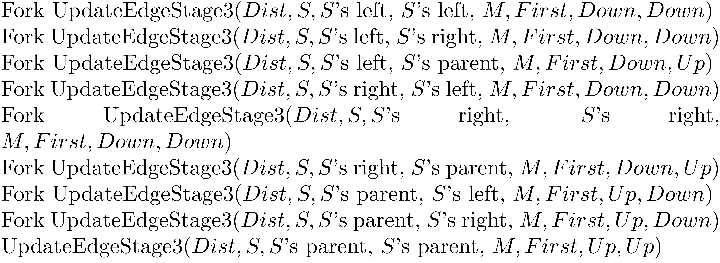
Implementation
Supernodal Floyd-Warshall algorithm

Slide 66
Implementation
Supernodal Floyd-Warshall algorithm
For Rows
Mutex blocks
For Cols

Slide 67
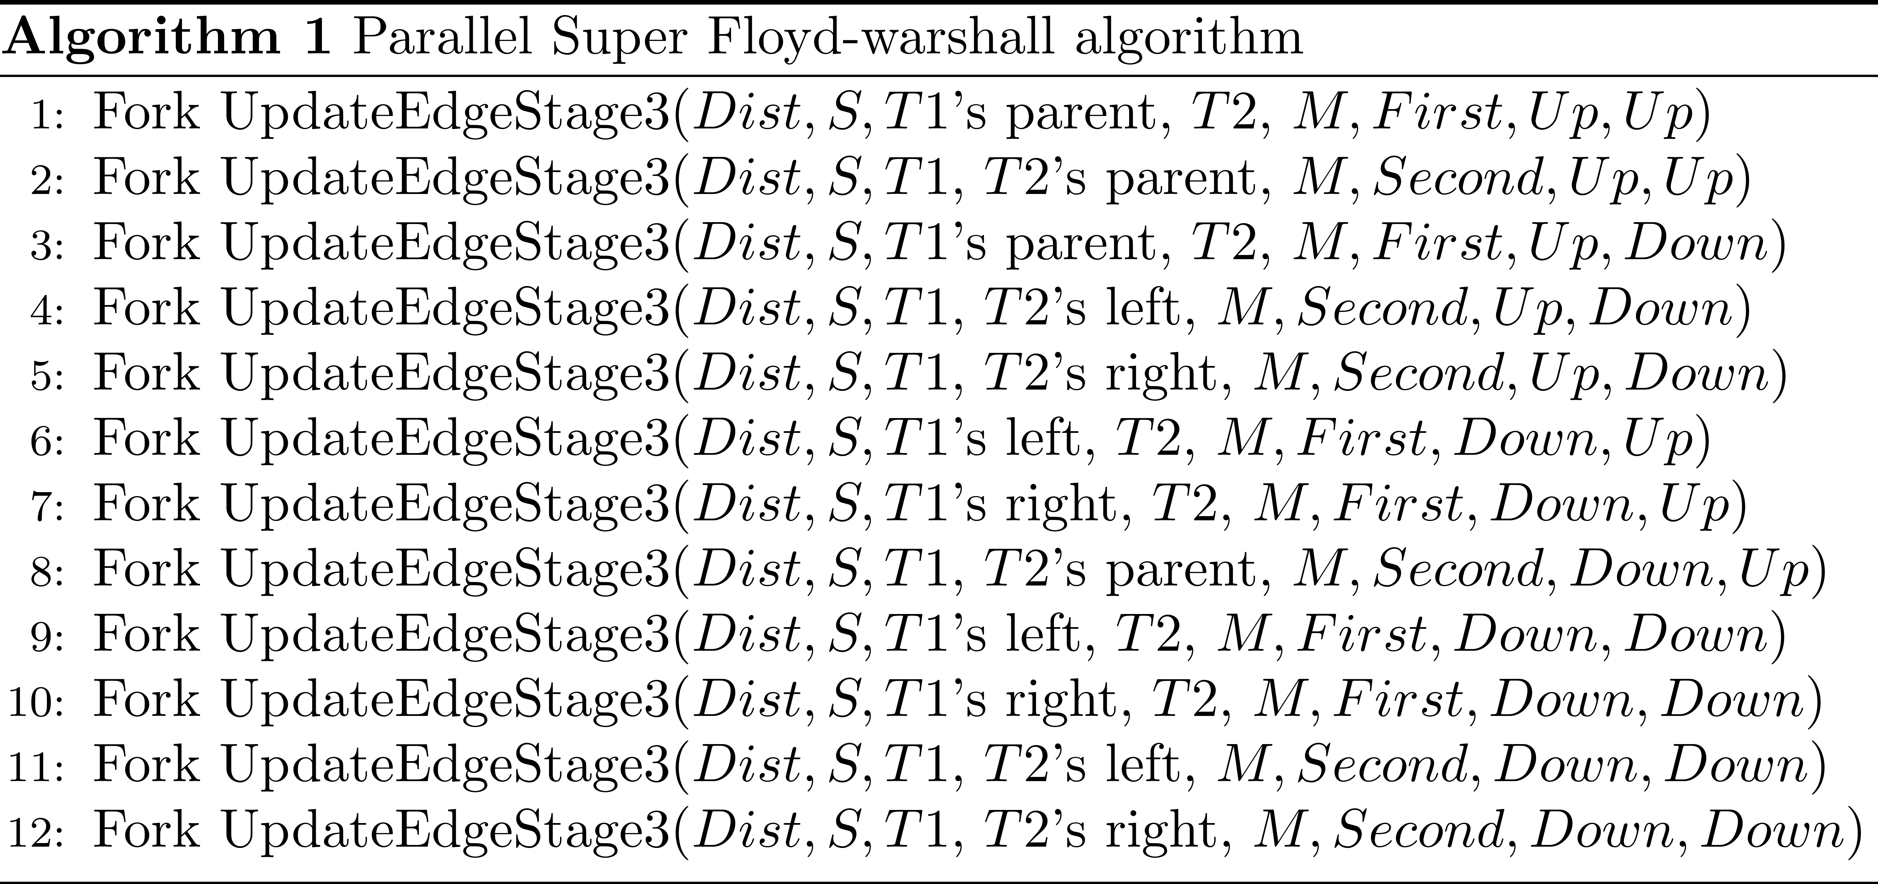
Implementation
Supernodal Floyd-Warshall algorithm

Slide 68
Implementation
Supernodal Floyd-Warshall algorithm
Tree iterate

Slide 69
Implementation
Supernodal Floyd-Warshall algorithm
Potential collision: mutex

Slide 70
Implementation
Nested dissection
Ideality function
Fulfill the requirement of nested dissection
Choose the maximum Ideal case
Smaller better

Slide 71
Implementation
Nested dissection
Ideality function
Fulfill the requirement of nested dissection
Choose the maximum Ideal case
Smaller better

Slide 72
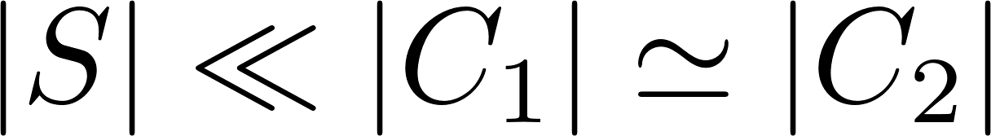
Implementation
Nested dissection
Ideality function
Fulfill the requirement of nested dissection
Choose the maximum Ideal case
Smaller better

Slide 73
Implementation
Nested dissection
Ideality function
Fulfill the requirement of nested dissection
Choose the maximum Ideal case
Smaller better

Slide 74
Implementation
Nested dissection
METIS
Support Nested Dissection
Don’t provide separator informations
Provide permutation table

Slide 75
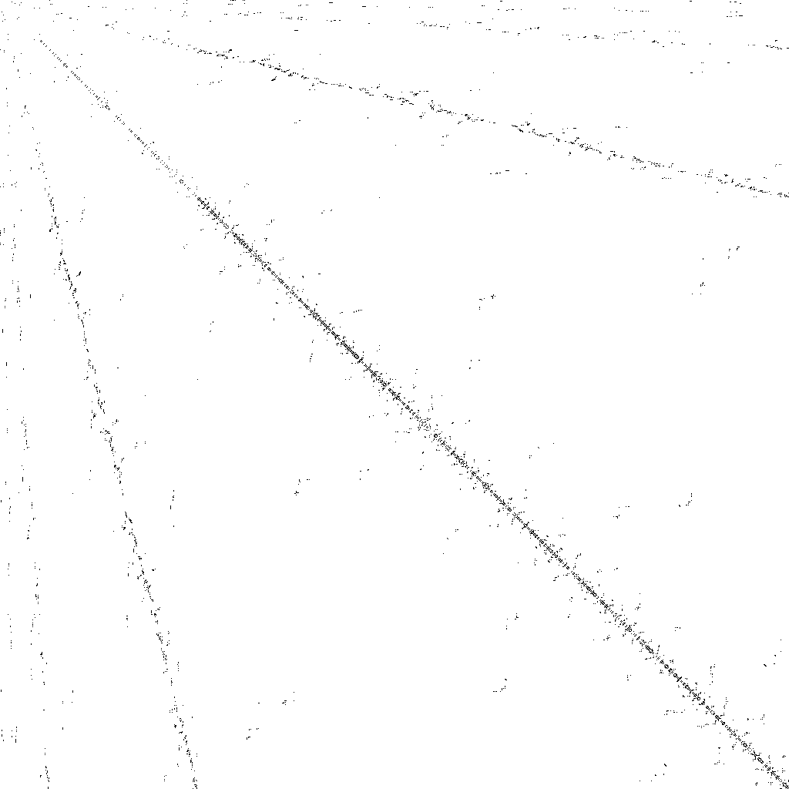
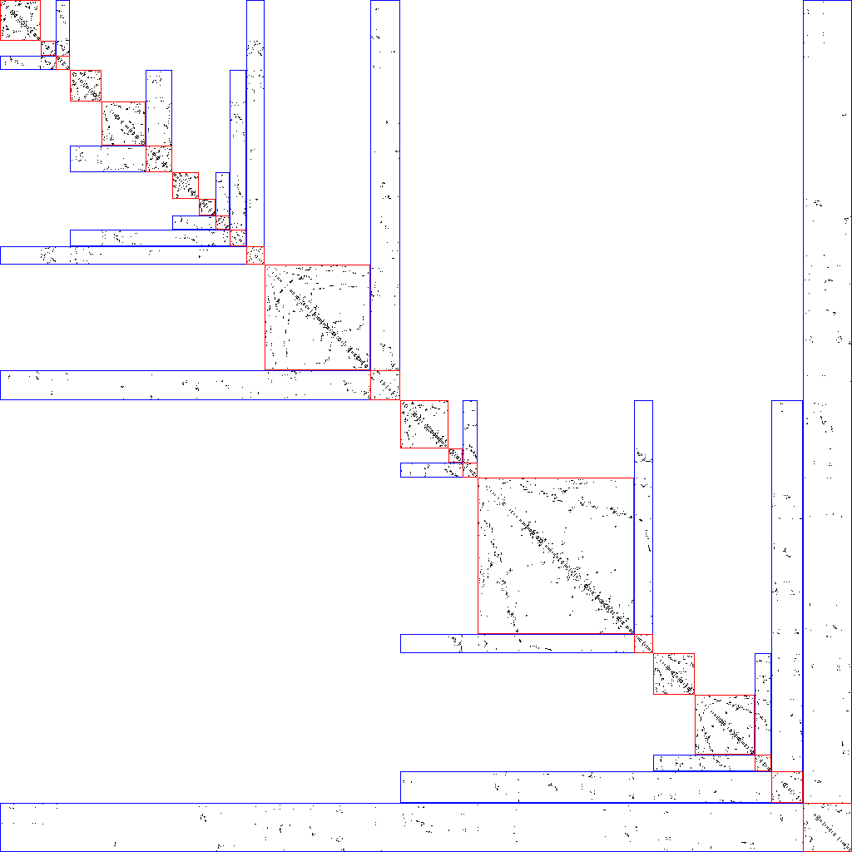
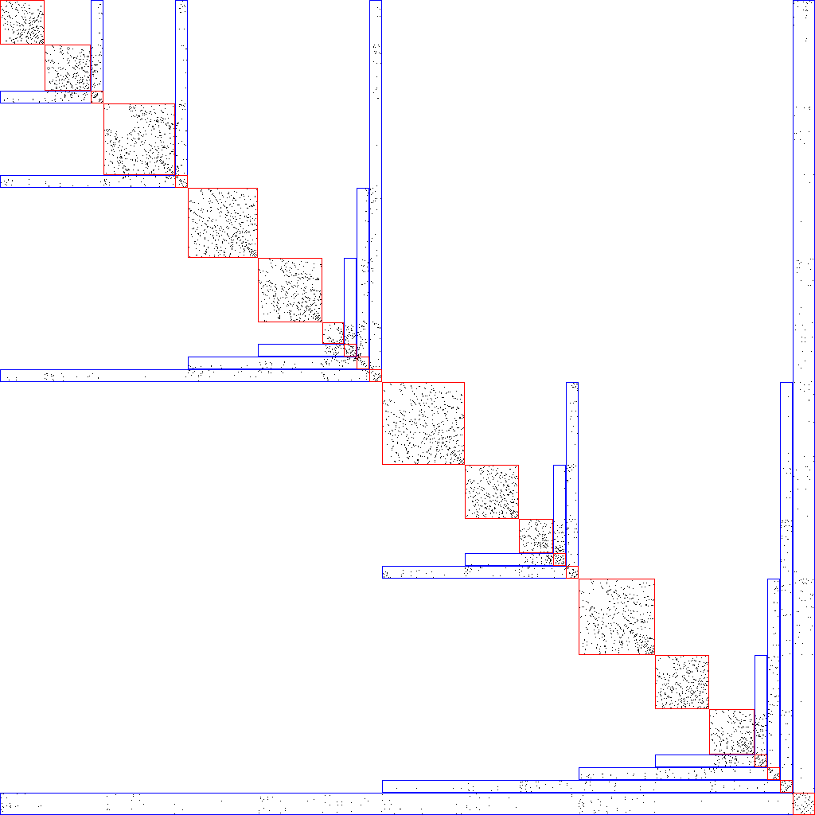
Implementation
Nested dissection
Input
BFS work
METIS work
Graph : delaunay_n10

Slide 76
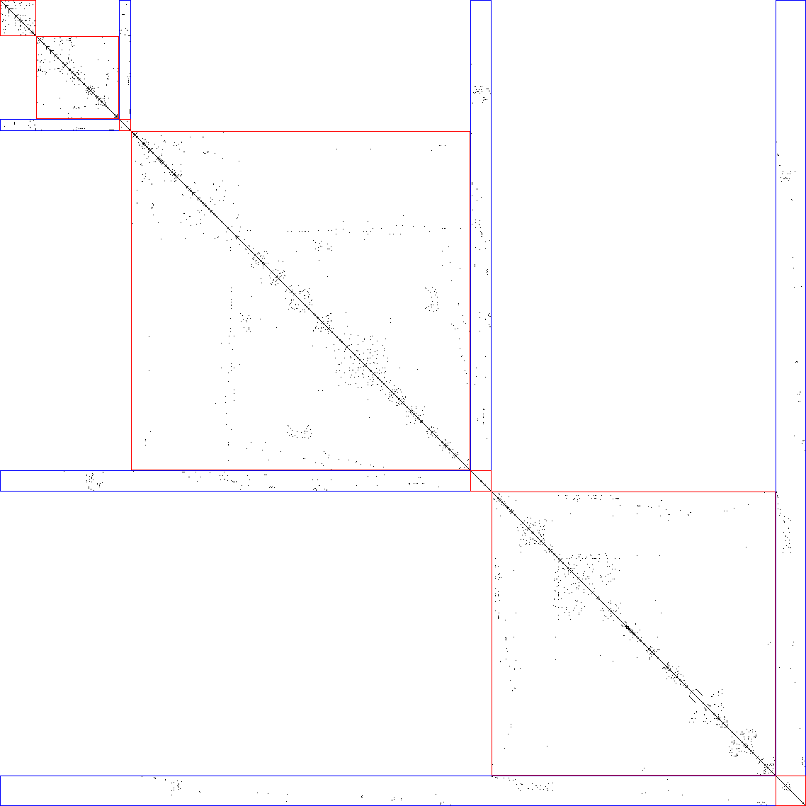
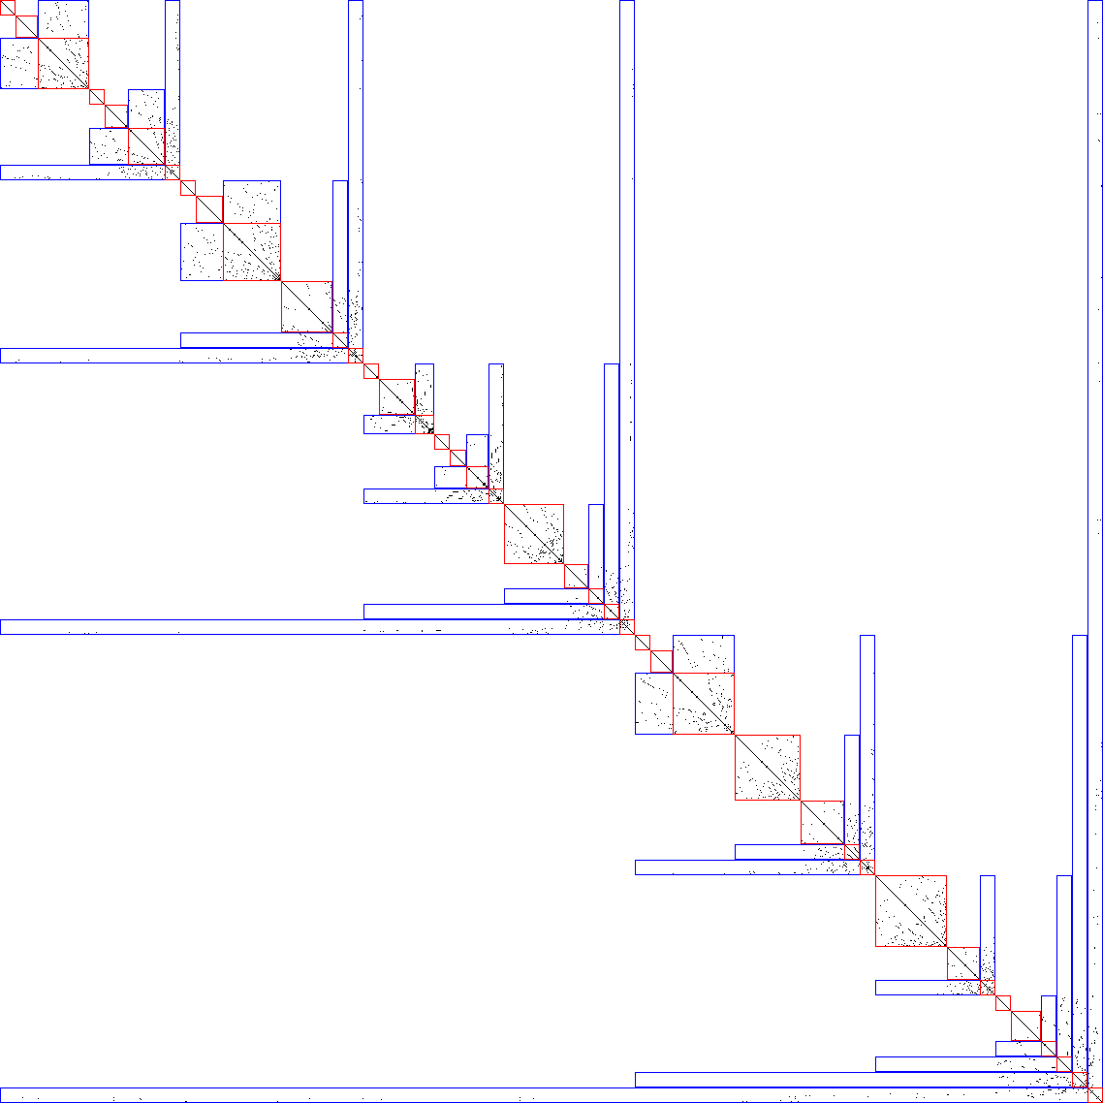
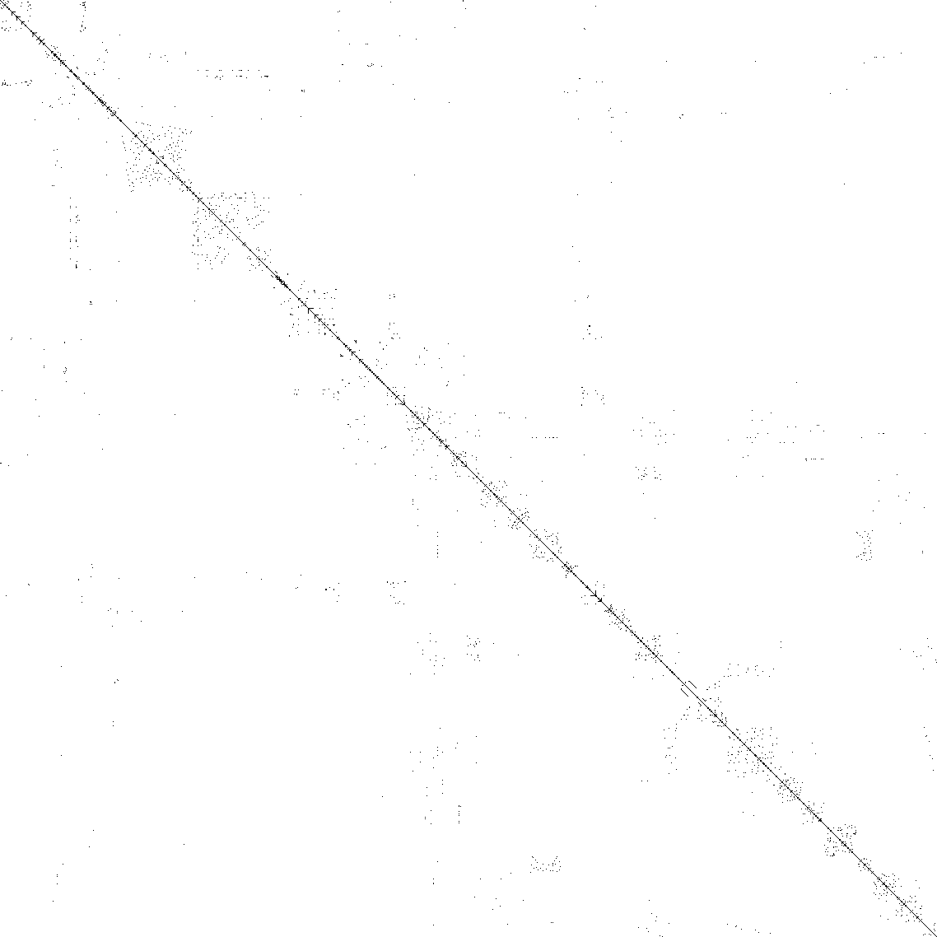
Implementation
Nested dissection
METIS work
Input
BFS work
Graph : 1138_bus

Slide 77
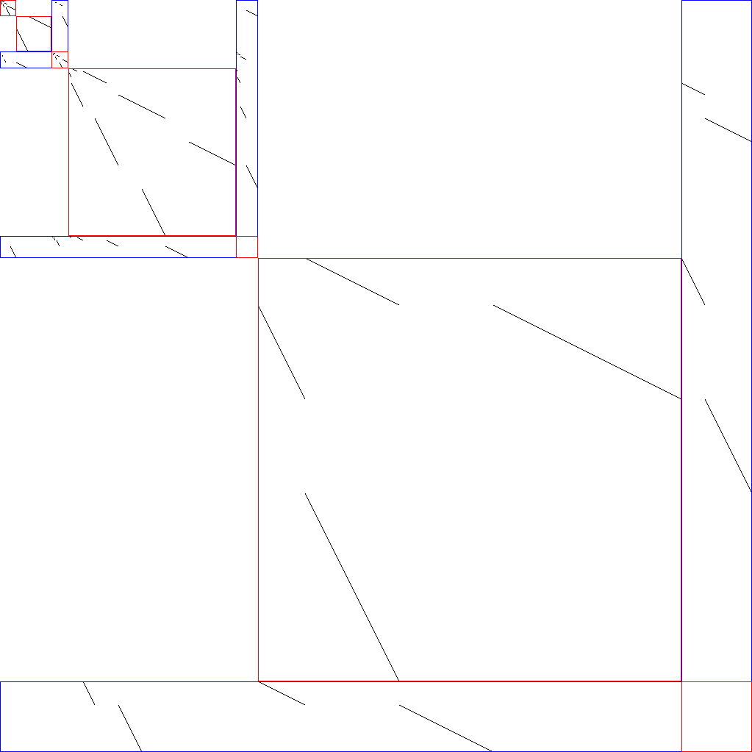
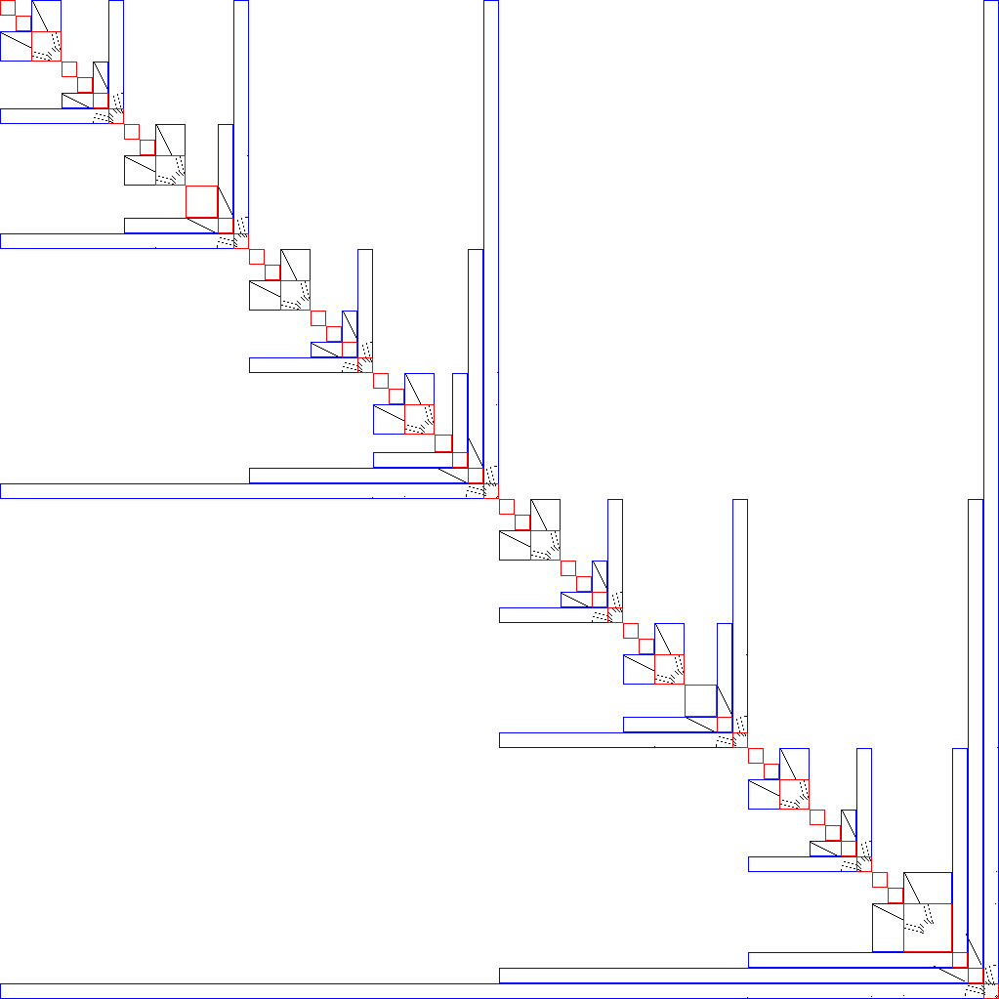

Implementation
Nested dissection
METIS work
Input
BFS work
Graph : Tree_1023

Slide 78
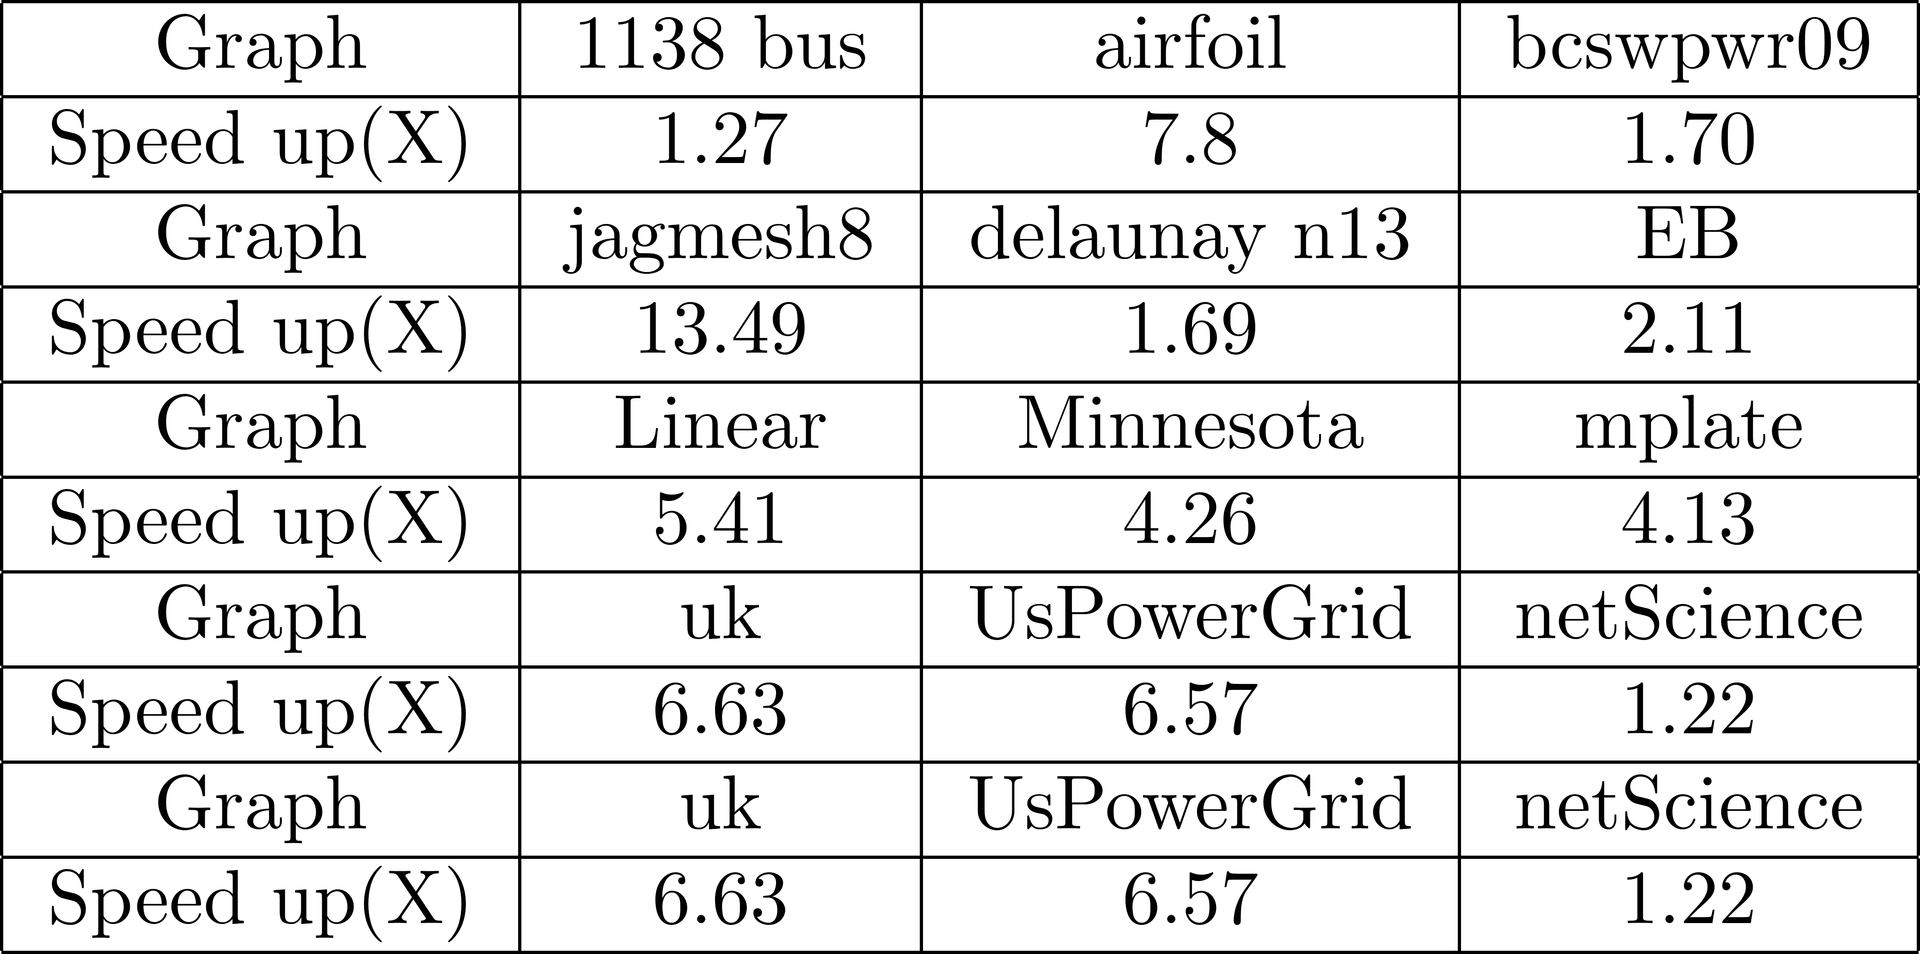
Experiment
Table 1. Speedup in comparison with Multi-threaded Blocked Floyd-Warsahll on graphs from Suite Sparse Collection and theorical graphs

Slide 79
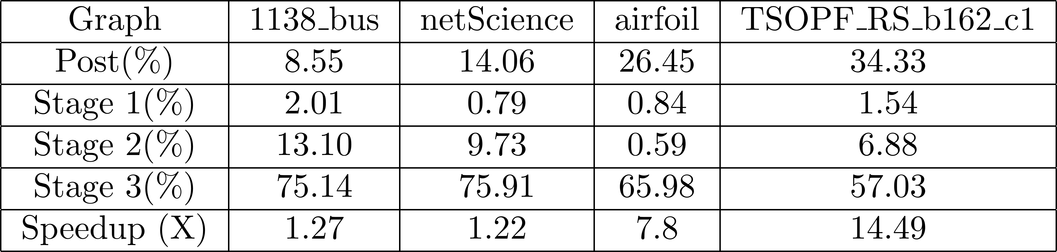
Experiment
Table 2. Cost of each stage

Slide 80
Future works
Future works
Nested dissection
Normal METIS(This paper may used)
ParMETIS(Parallelize METIS)
Modern METIS(OpenMP implementation)
Just came up
Normal Floyd-Warshall function in Super Floyd-Warshall
Naïve Floyd-Warshall
Blocked Floyd-Warshall algorithm
Guarantees to be better than Blocked Floyd-Warshall
GPU implementation (Semi-ring algebra)
Better performance at big enough blocks
OpenMP implantation(This paper may used)
Up to x123 from this paper’s report

Slide 81
Other observation
Which format to represent the graph
Adjacency matrix
Result matrix
CSR(compressed sparse row representation)
Input graph
Computation over which format?
Conversion needs cost
METIS requires CSR
This project used this with the conversion

Slide 82
Thank you
Any comments and questions

